Slide 1

Advancement in PROTEUS ANR
PHD of Sébastien Velut

Slide 2
What I have done ?
Checked usefulness of riemannian manifold
Checked that recentering and spatial filtering improved the classification accuracy
Tested wavelets transforms as features extractor

Slide 3
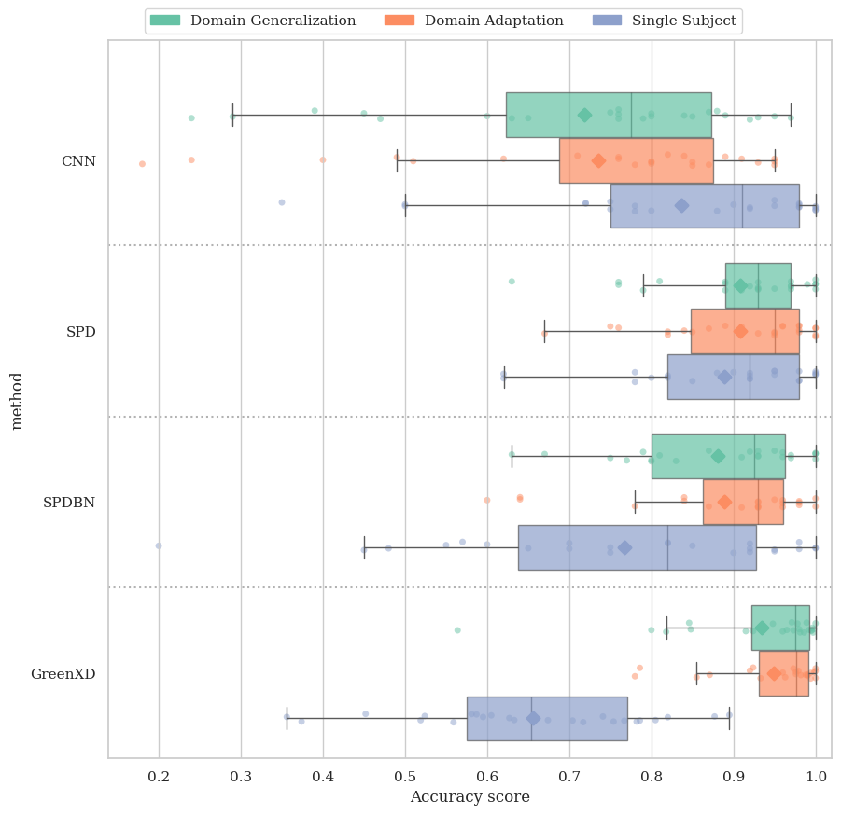
Results ESANN Paper with GREEN algorithm Results

Slide 4
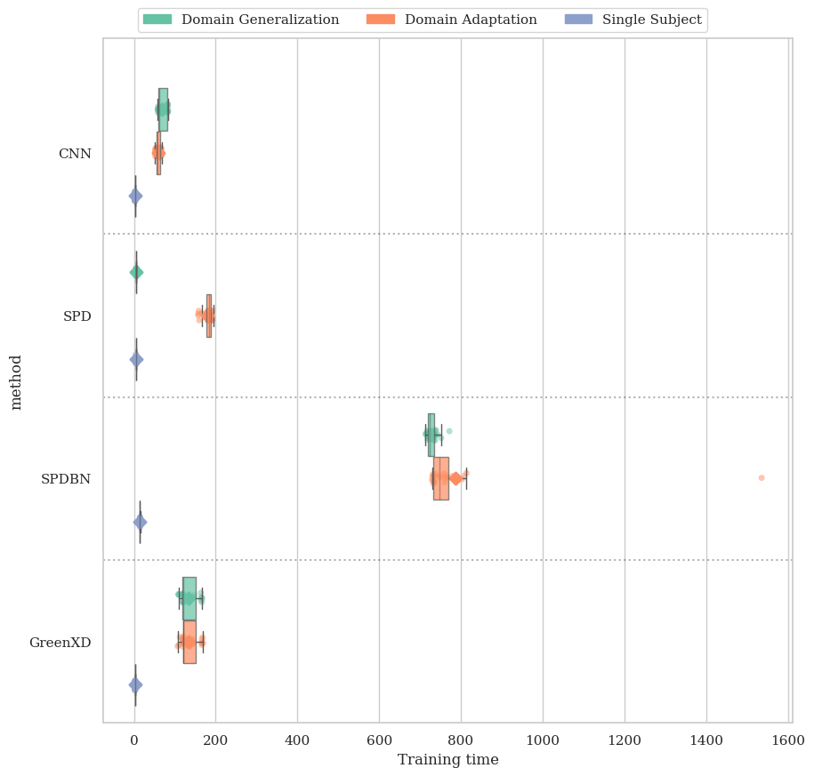
Results ESANN Paper with GREEN algorithm Results

Slide 5
What I am doing now ?
Finding similar subject to train on less data but having the same accuracy.
Finding the best threshold
Testing if SPD, CNN or GREEN algorithm is better

Slide 6
What I will do ?
Transform EEG data to BIDS format (Creation of a semi-automated program)
Test similarity algorithm on different threshold, on a new dataset
Find and test more performant similarity algorithm

